Slide 1




Semantics in Intelligent Information Access
2023/2024
SUSTAINAMEAL
AI-Powered Recipe Recommendations for Sustainable Eating
Giovanni Tempesta
Michele Di Carlo

Slide 2
Content
01
Overview
02
Related Works
03
Datasets
04
Sustainameal
05
Experiments
06
Qualitative Analysis
07
Conclusion and Future Works

Slide 3
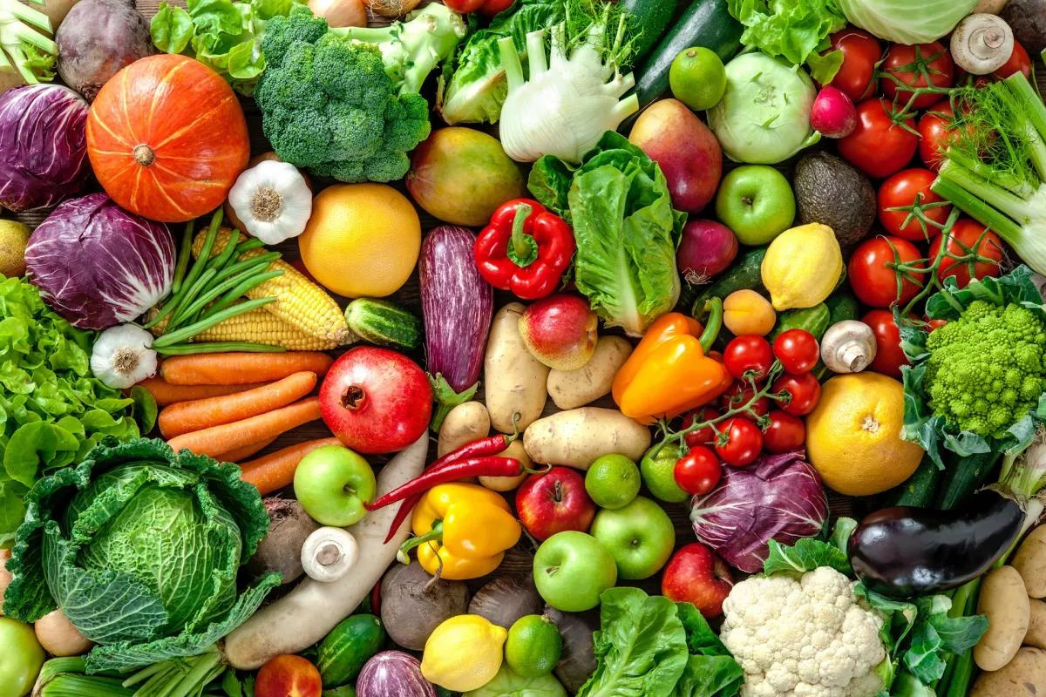


Health & Diet Connection
Introduction to the problem
Sustainable Eating
In the face of escalating health issues and environmental concerns, our proposal confronts the critical need for a dietary shift that prioritizes both personal health and ecological well-being.
The environmental cost of food production is unsustainable, prompting a movement towards diets that have a lower ecological footprint.

Slide 4

TASK
In the face of escalating health issues and environmental concerns, our project confronts the critical need for a dietary shift that prioritizes both personal health and ecological well-being.
“ We need to build a system which given a recipe name suggest an alternative recipe which is more healthier and sustainable”

Slide 5



TASK
Data Analysis and Preprocessing
Healthiness and Sustanability Approach
AI-Powered
Starting with a diverse web-sourced recipe dataset we analyzed and reduced them through a preprocessing process
For each recipe we've applied data processing to calculate each ingredient's CFP (carbon foot print) and WFP (water foot print)
we will use the power of artificial intelligence tools (such as transformers and large language models) to suggest alternative recipes

Slide 6

STARTING POINT
“ We need to build a system which given a recipe name suggest an alternative recipe which is more healthier and sustainable ”

Slide 7
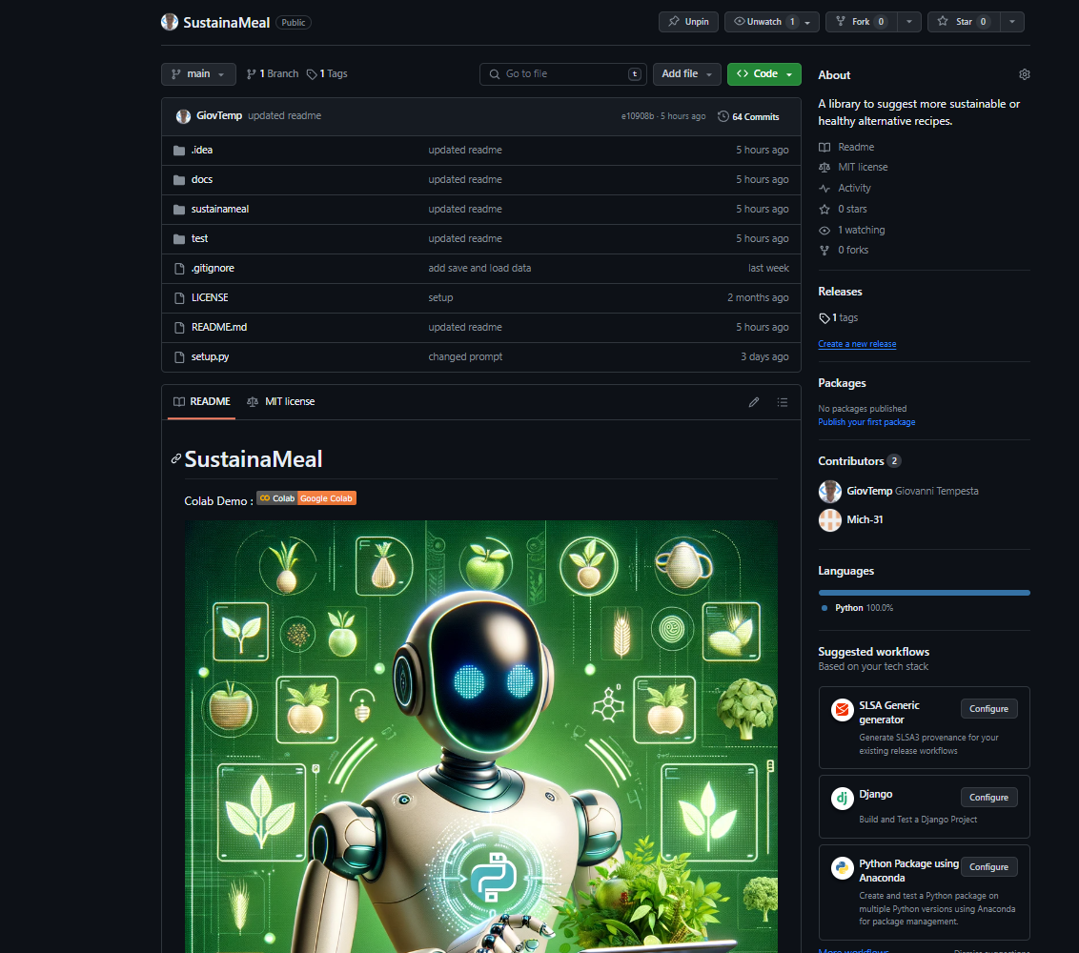



PROPOSAL

Slide 8


RELATED WORKS

Slide 9
FoodPrintDB
The research "FoodPrintDB" by Gigantelli Alberto and Iacovazzi Antonio Raffaele aimed to create a comprehensive database of ingredients and recipes for future food recommendation systems, focusing on high-quality, reliable information with a special emphasis on sustainability. The database offers valuable insights into sustainability, facilitating the identification of sustainable alternatives for specific recipes. The parameters considered
to evaluate sustainability were the Carbon Foot Print and the Water Foot Print.
First Version
The first version of the database was originally released by two other colleagues, Matteo Fusillo and Salvatore Amoruso, as support for their recommendation system
Second Version
Subsequently, additional information from the SU-EATABLE Life database was integrated into this initial version. In particular, the Carbon Foot Print and Water Foot Print values were added

Slide 10
DATASETS

Slide 11
Datasets Description
Recipes Dataset
CSEL Dataset
The recipes in our dataset were obtained through a comprehensive web scraping
process. This involved systematically collecting data from various online culinary
websites and recipe databases.
The dataset comes from an elaboration of the SU-EATABLE Life(SEL) database,
which is a multilevel database on the carbon (CF) and water footprint (WF) values
of food raw materials

Slide 12
EDA

Slide 13
RECIPES DATASET
Recipe Attributes
recipe_id
title
ingredients
tags
A unique identifier for each recipe
The name of the recipe.
List of ingredients used in the recipe
Categorization tags associated with each recipe
= attributes used in the workflow

Slide 14

Tags
The dataset has a total of 902 tags, for example we have:
Main dish = 71285
Desserts = 42807
Breakfast = 13384
Appetizers = 20187
Vegetables = 53485
Meat = 50740
Seafood = 14722
Vegetarian = 35599
Fruit = 31245
Pasta rice and grains = 23924
Chicken = 20304
Pork = 12664
......

Slide 15
RECIPES DATASET
Macronutrients
calories [cal]
caloriesFromFat [cal]
totalFat [g]
cholesterol [mg]
sodium [mg]
The total calorie content of the recipe
The amount of calories derived from fat
Total fat content in grams
Cholesterol content in milligrams
Sodium content in milligrams
totalCarbohydrate [g]
dietaryFiber [g]
sugars [g]
protein [g]
Total carbohydrates in grams.
Dietary fiber content in grams
Total sugars in grams
Protein content in grams

Slide 16
RECIPES DATASET
Scores
who_score
fsa_score
nutri_score
A healthiness score for each recipe based on the World Health
Organization (WHO) methodology, ranging from 0 to 14, with 14 being the
best
A healthiness score based on the UK Food Standards Agency
(FSA) nutrient profiling system, ranging from 0 to 8, with 8 being the best.
A nutritional score for each recipe, graded from A (best) to E
(worst)

Slide 17
1
Dataset noise
('dried cranberries', '1 time(s) cup ')
the unstructured nature of web-sourced
recipe data
Limitations
2
Null tags and ingredients
The structure of recipes dataset presents some important limitations that requires some strategies to reduce its impact on our analisis
On 507 000 recipes only 214 000 were suitable for our use case because they had ingredients and tags other than null

Slide 18
CSEL DATASET
Food Commodity Columns
Food Commodity GROUP
Food commodity ITEM
Food commodity TYPOLOGY
Food commodity sub-TYPOLOGY
The general category to which food goods
belong
Specific ingredient within the category
Subcategory within a food group, particular typology
Subcategory of the subcategory within a food group

Slide 19
CSEL DATASET
Foot Prints
final_co2
final_wfp
Final value of Carbon Foot Print
Final value of Water Foot Print

Slide 20
1
Dataset noise
Presence of additional word and character
2
Limitations
Limited ingredients
Only 471 items
The CSEL dataset faces some important limitations that are challenging for us. To address these challenges, we’ve resorted to employing
methodologies outlined in the data preprocessing section.
3
Absence of common ingredients
Some important ingredients are missing

Slide 21
PREPROCESSING

Slide 22
Recipe Dataset Reduction
01 - Removing duplicates
Recipes with identical titles are dropped
02 - Removing Null Tags Recipes
Recipes with ’tags’ property as null are dropped
03 - Removing Null Ingredients Recipes
This step reduced recipes from 507.335 to 214.800
Recipes with ’ingredients’ property as null are dropped

Slide 23
Recipe Dataset Cleaning
01 - Text Cleaning
Removal of adjectives, stopwords, verbs, numbers, special characters and content within parentheses
Caramel Sweetened Condensed Milk
Caramel Milk

Slide 24
CSEL Dataset Cleaning
01 - Removing no cfp and wfp ingredients
Removal of ingredients lacking both cfp and wfp values
02 - Text Cleaning
Dark Chocolate
Elimination of adjectives, stopwords, and special characters like asterisks (*).
Chocolate
03 - Removing Parenthesis
Removal of all parentheses and their contents, e.g., ’( F )’, ’( G )’, etc
Carrots (F)
Carrots
This step reduced igredients from 471 to 448

Slide 25
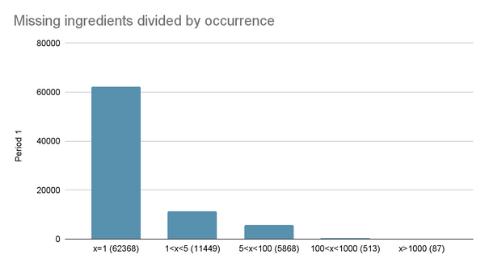
Ingredient Matching
01 - Ingredients Checking(CSEL -> Recipe Dataset)
Checking if the CSEL dataset ingredient name is contained within our ingredient name.
Milk low-fat Milk
02 - Ingredients Checking(Recipe Dataset -> CSEL)
Checking if the ingredient name is contained within the CSEL ingredient name
Beef Beef Bone Free Meat
This matching process assigned 78.998 out of 159.284 ingredients

Slide 26
Transformer Usage for Missing Ingredients
01 - Transformer
Used a transformer to calculate similarity between missing ingredients (occurring more than 1 time) and matched ingredients
02 - Threshold
Set a threshold of 0.98 as the minimum similarity
03 - Filtering results
Obtained around 240 possible similarities, manually reviewing and eliminating the inconsistent ones, resulting in 178 similarities.
Turkey neck bone Turkey meat bone Turkey Meat

Slide 27
Manual Assignment of Most Relevant Missing Ingredients
01 - Assignments
After automated analysis, further manual intervention addressed 87 missing ingredients with more than 1000 occurrences, finding 19 possible associations.
gorgonzola cheese

Slide 28
Creation of Dictionary
01 - Dictionary
Created a dictionary containing names of all processed ingredients with their respective cfp and wfp values

Slide 29
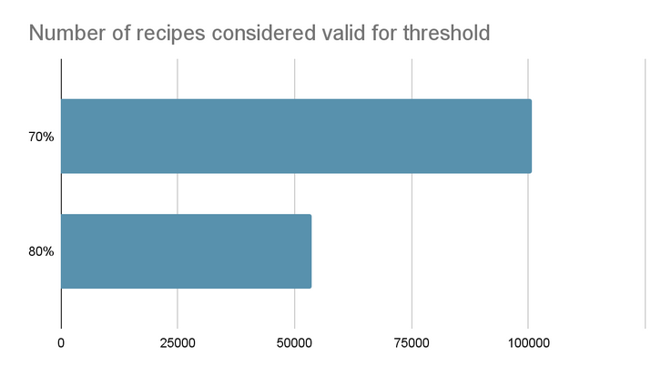
Recipes dataset reduction
We employ the same approach as the previous work ’Food
Print DB’ for managing recipes with missing ingredients. Thus, we proceed to reduce our dataset by
eliminating all recipes that we do not deem valid
Valid Recipe
The percentage of known and valid ingredients is greater than a specified
threshold.
An ingredient is considered valid if we have the values for both cfp and wfp
Currently we have decided to use recipes that respect the threshold constraint of
70% (100.870 out of 214.800). Therefore the final number of recipes is 100.870

Slide 30
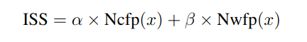
Sustainability Calculation Procedure
ISS(Ingredient Sustainability Score)
The ISS (Ingredient Sustainability Score) was computed for each ingredient within the recipe employing
the ’iss score’ function.
alpha
Ncfp(x)
beta
Nwfp(x)
A constant value setted to 0.8
Ncfp(x) represents the normalized Carbon
Foot Print value
A costant value setted to 0.2
Nwfp(x) denotes the normalized Water Foot Print value for
the ingredient

Slide 31
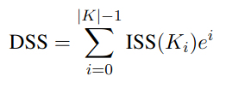
Sustainability Calculation Procedure
DSS(Dish Sustainability Score)
After obtaining the ISS for each ingredient within the recipe, the DSS (Recipe Sustainability Score) was calculated using the formula:
ISS(K )
i
i
e
The ISS value of the i-th ingredient of K, where K is a set of ingredients oredered descending by the ISS score
Numeric costant with a value of 2.71

Slide 32
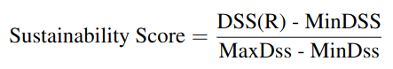
Sustainability Calculation Procedure
Normalization of the DSS
Finally, the ultimate sustainability score was computed using the formula:
DSS(R)
MinDSS
MaxDSS
The DSS value of the recipe R
Minimum value between all the DSS scores
Maximal value between all the DSS scores

Slide 33
Sustainability Calculation Procedure
Label Assignment
Employing a similar methodology as in the previous study, we assign labels to each recipe based on the computed score. Recipes are categorized
into three labels:
Low(0)
Medium(1)
High(2)
Indicating recipes with low sustainability(score >= 0.5)
Representing moderately sustainable recipes(0.1 < score < 0.5)
Indicating highly sustainable recipes(score<=0.1)
*In order to guarantee uniformity with the other scores in our library , we inverted this score (1-score) in the initialization phase of the library

Slide 34
SUSTAINAMEAL
WORKFLOW

Slide 35
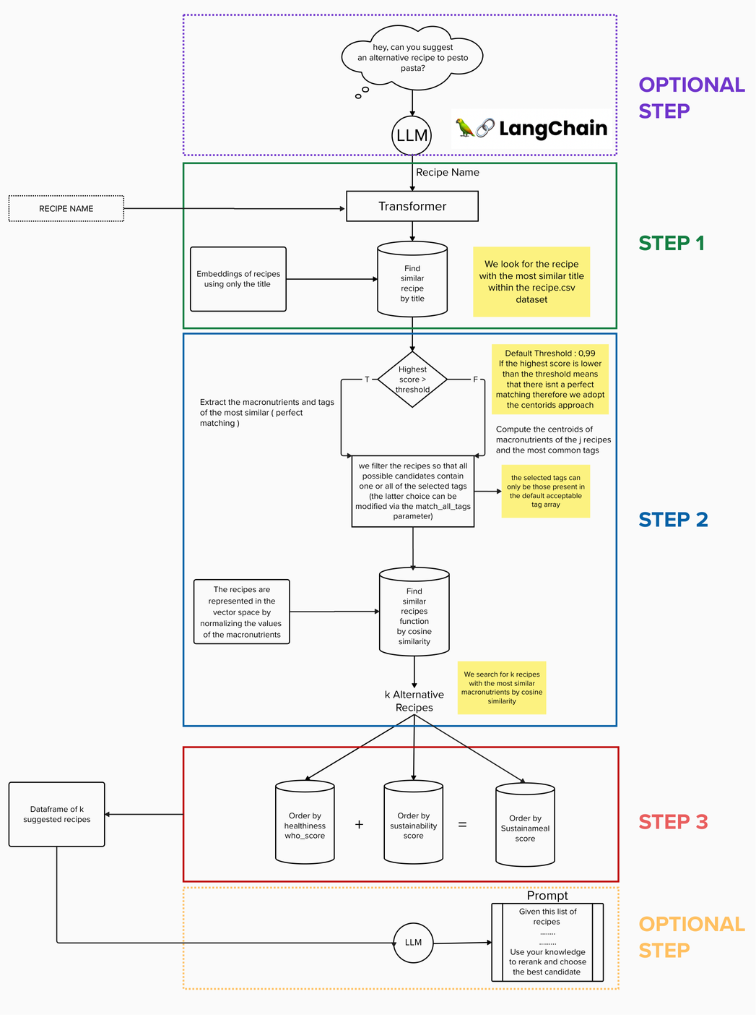
WORKFLOW
LET'S ANALYZE IT STEP BY STEP

Slide 36
INITIALIZATION
“WHAT DO I NEED?”

Slide 37
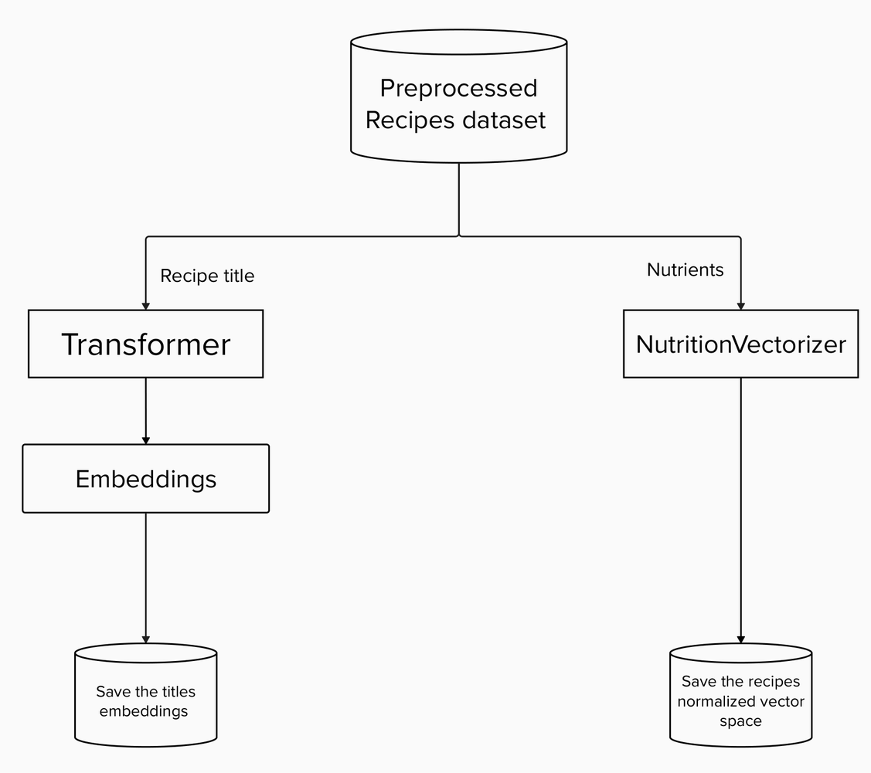
INITIALIZATION
01
We compute the title embeddings
02
We compute the recipes vector space through the nutrients
03
*In order to guarantee uniformity with the other scores in our library , we inverted this score (1-score) in the initialization phase of the library

Slide 38
STEP 1
“DID I KNOWN THE RECIPE?”

Slide 39
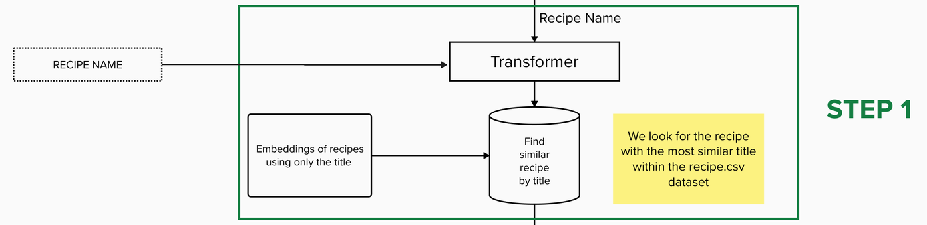
STEP 1
01
We get the recipe title
02
We use the transformer to obtain the title embedding
03
We look for k the recipe with the most similar embedding within our dataset

Slide 40
STEP 2
“LET’S FIND SOME SIMILAR RECIPE”

Slide 41
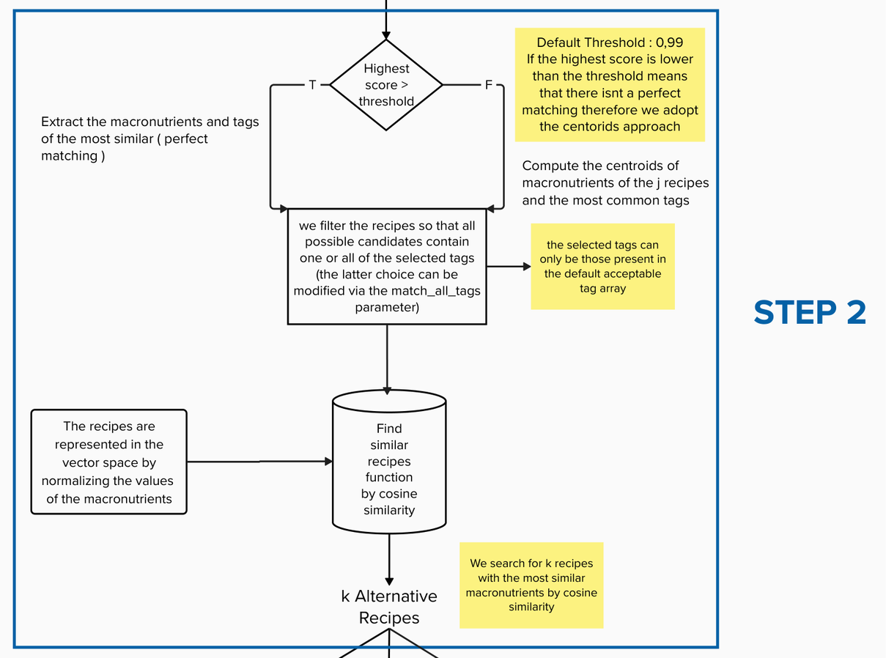
STEP 2
01
Check if we already known the recipe
02
We get the macronutrients and the tags
03
We filter the recipes by tags
04
We get the k most similar recipes by macronutriens

Slide 42
STEP 3
“LET’S ORDER THE RECIPES FOR SUSTAINABILITY AND HEALTHINESS”

Slide 43
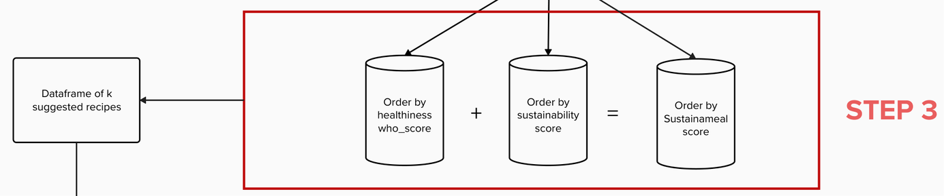

STEP 3
01
We reorder the recipes by healthiness
02
We reorder the recipes by sustanability scores
03
We reorder the recipes by Sustainameal score

Slide 44
OPTIONAL STEP
“WHICH RECIPE IS THE BEST?”

Slide 45

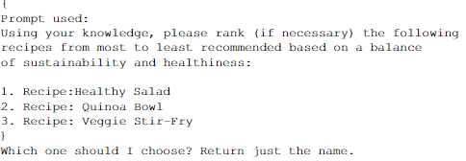
OPTIONAL STEP
01
Given a Dataframe of suggested recipes order by sustainameal score
02
We use the Gpt-3.5-turbo to rerank the recipes and to get the top 1

Slide 46
OPTIONAL STEP
“PRIMOARDIAL AGENT”

Slide 47

OPTIONAL STEP
As optional step we can initialize a primordial version (developed with LangChain) of an agent which can handle a generic question such as “ Can you suggest an alternative recipe to pesto pasta?”

Slide 48
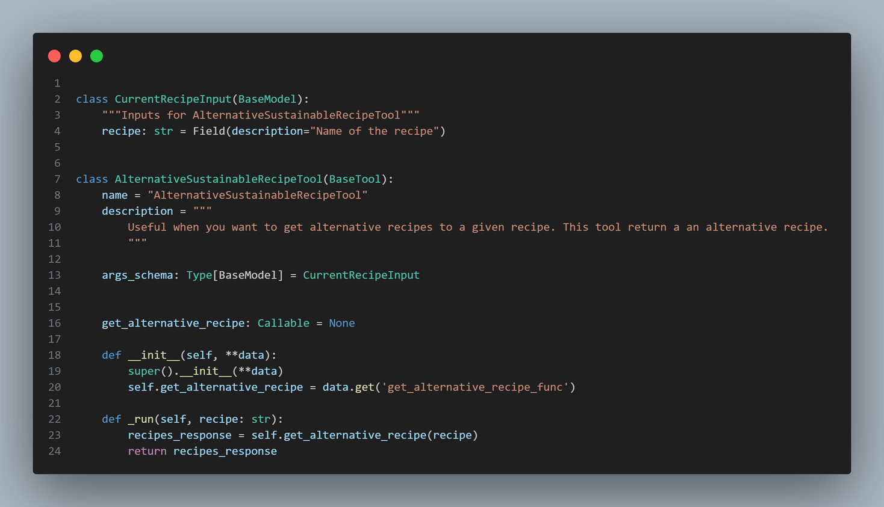
LANGCHAIN
LangChain's flexible abstractions and extensive toolkit unlocks developers to build context-aware, reasoning LLM applications.
Tools are interfaces that an agent can use to interact with the world. They combine a few things:
The name of the tool
A description of what the tool is
Schema of what the inputs to the tool are
The function to call
Whether the result of a tool should be returned directly to the user

Slide 49
SUSTAINAMEAL
FUNCTIONALITIES

Slide 50

Functionalities
Find similar recipes by title
Find similar recipes by nutriens
Order by Healthiness
Order by Sustainability
Order by SustainaMeal score
Gpt ReRank
Primordial Conversational Agent
CMD scripts
Save and Load Data

Slide 51
EXPERIMENTS

Slide 52




Scenario 1
100 recipes with a WHO score above average
Scenario 2
100 recipes labeled as 1 (moderately sustainable)
Experiments
We conducted experiments on 4 distinct scenario
Scenario 3
100 recipes labeled as 2 (highly unsustainable)
Scenario 4
Unknown recipes

Slide 53


Different Configurations
K=1 , 10 , 50 , 100
Number of candidates
nutrients (A) = [Calories [cal] , Total Fat [g],
Sodium [mg],Dietary Fiber [g] , Sugars [g], Protein [g]]
Nutrients for the vector space computation
nutrients (B) = Calories [cal] , Total Fat [g] , Saturated Fat [g] ,Cholesterol [mg] , Sodium [mg] , Dietary Fiber [g] , Sugars [g] , Protein [g]
match_all_tags=True , False
Filtering Strategy
5000
average increase
on sustainameal
score
Experiments

Slide 54
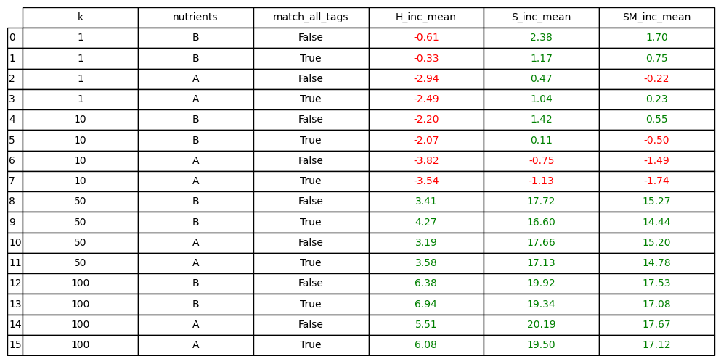
In this first scenario, we are working with consists of recipes that are already moderately healthy.
Scenario 1
01
With a low value of k, in terms of healthiness, our algorithm tends to suggest recipes that do not result in a real increase in nutritional values but rather a decrease, unlike the sustainability
02
Increasing k the results improved
03
k = 1 makes the library unusable

Slide 55
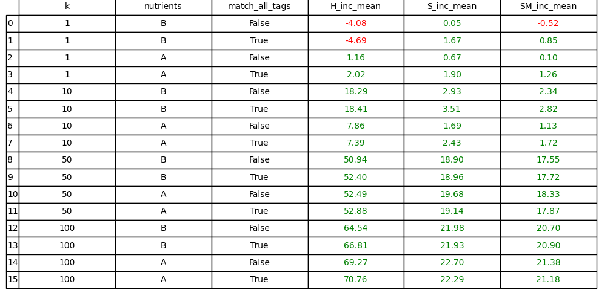
Scenario 2
In this second scenario, where we are considering recipes that are moderately sustainable
01
There is an increase in all possible configurations, except for the configurations with k = 1 and nutrients of type B

Slide 56
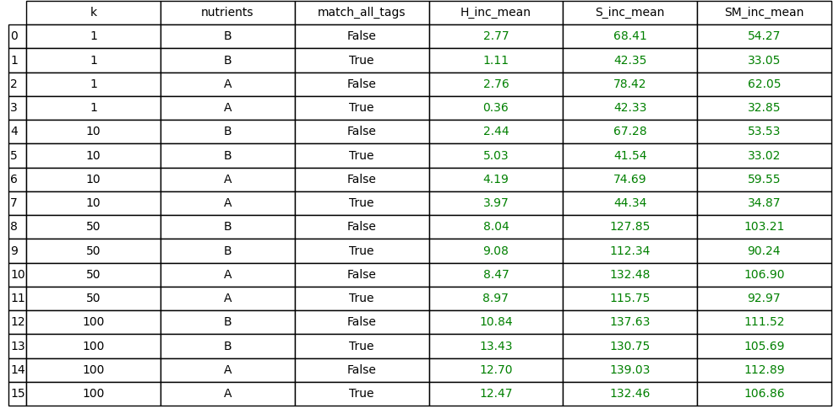
Scenario 3
In this scenario we used only unsustainable recipes
01
Employing solely unsustainable recipes, we will consistently experience increments in terms of sustainability across all conceivable parameter configurations

Slide 57
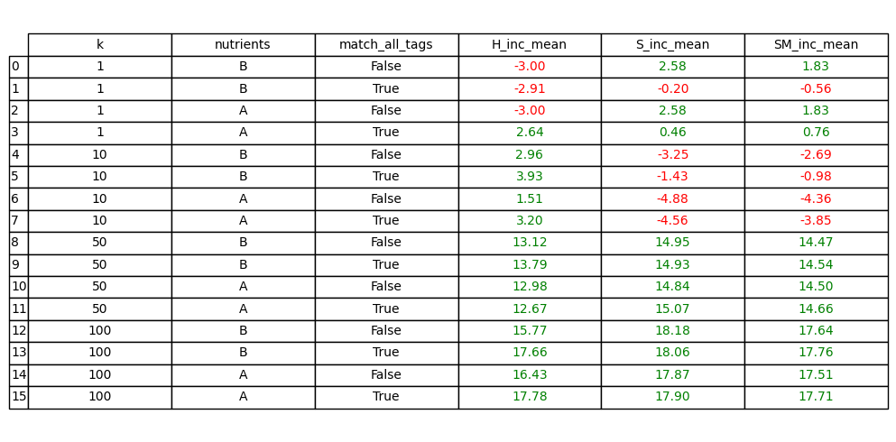
In this scenario we considered only recipes which are not present in our dataset
Scenario 4
01
As observed from the table, when considering recipes not present in our dataset, with k=1, there are decreases in terms of healthiness in almost all combinations, unlike sustainability.
02
With a k = 10, there is an increment for the healthiness, unlike the sustainability.
03
With a k > 10, there is an increment in all configurations both in the healthiness and in the sustainability

Slide 58
Best Configuration
K=50
nutrients = [Calories [cal] , Total Fat [g],
Sodium [mg],Dietary Fiber [g] , Sugars [g], Protein [g]]
tags = [’appetizers’, ’main-dish’, ’side-dishes’, ’drinks’,
’beverages’, ’fruits’, ’desserts’,’breakfast’,
’pasta-rice-and-grains’, ’rice’, ’pasta’,’pizza’,
’breads’, ’meat’, ’fish’,’seafood’, ’beef’,
’chicken’, ’vegetarian’]
match_all_tags=false
+19%
+45%
+38%
average increase
in healthiness
average increase
in sustanability
average increase
on sustainameal
score

Slide 59
EXPERIMENTS
WITH RERANKING

Slide 60
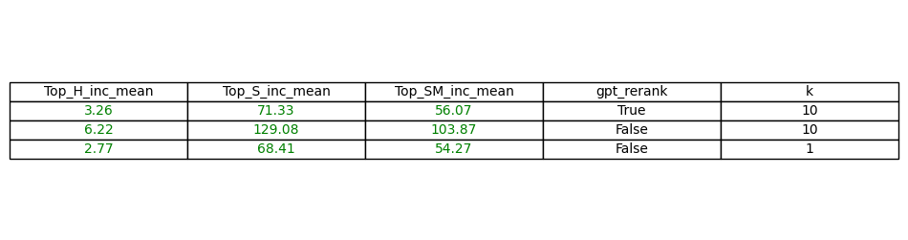
The following table illustrates the average increases in metrics for the top-ranked recipe.
We conducted two sets of comparisons:
the first set with k = 10 for both (to assess the extent of improvement lost when GPT is asked to rerank),
and the second set comparing the
results obtained without reranking at k = 1 against reranking with k = 10.
GPT Reranking
01
The data in the table shows that applying GPT reranking with k = 10 results in a significant increase in the average healthiness , sustainability scores and the sustainameal score, but certainly lower than the average increases of the top 1 recipes of the scenarios where reranking is not used
02
In contrast, without reranking at k = 1, the average increases
for healthiness and sustainability are lower than when reranking with k = 10, suggesting
that as we expected, reducing the number of candidates is not a recommended practice

Slide 61
QUALITATIVE ANALYSIS

Slide 62
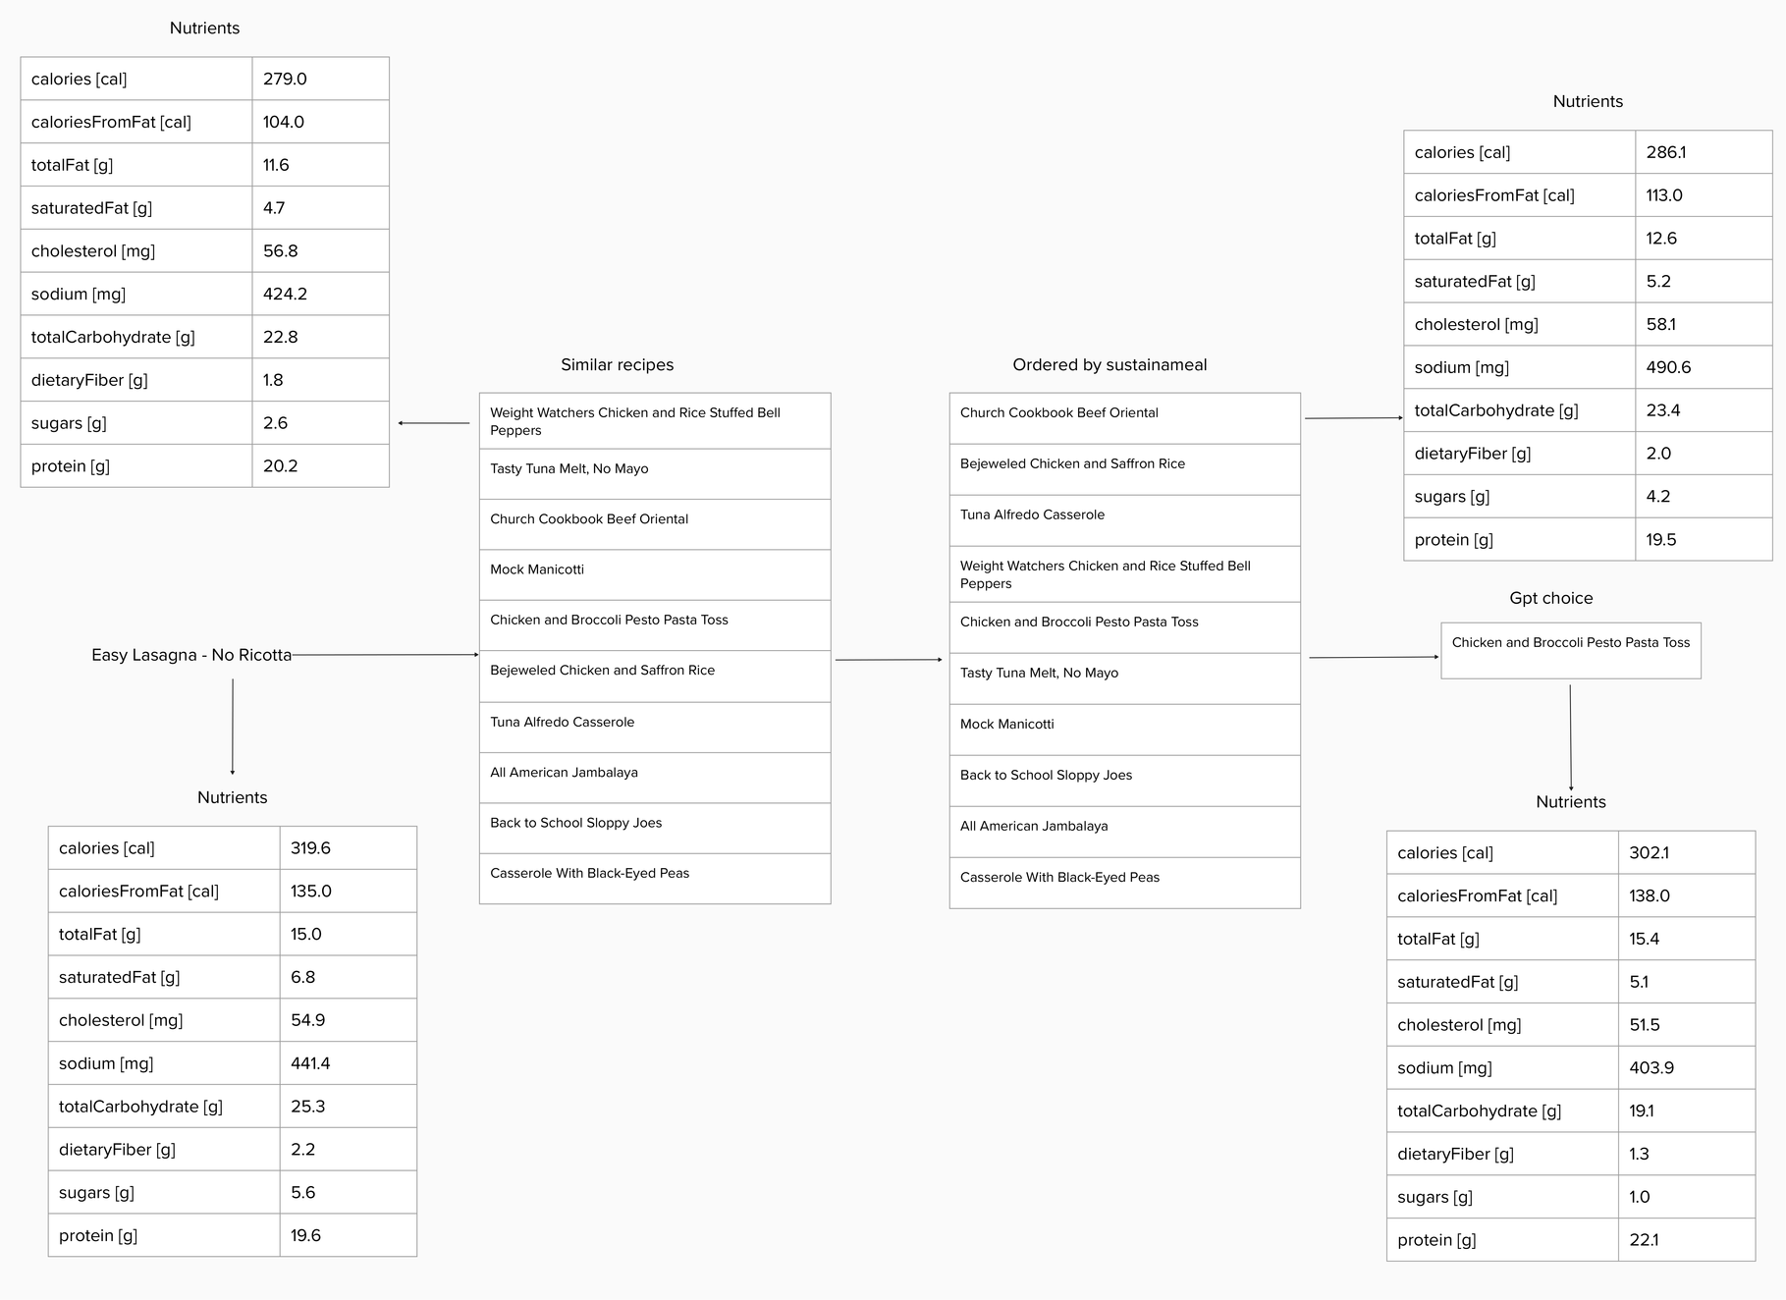
Qualitative
Analisis
1
Easy Lasagna - No Ricotta

Slide 63
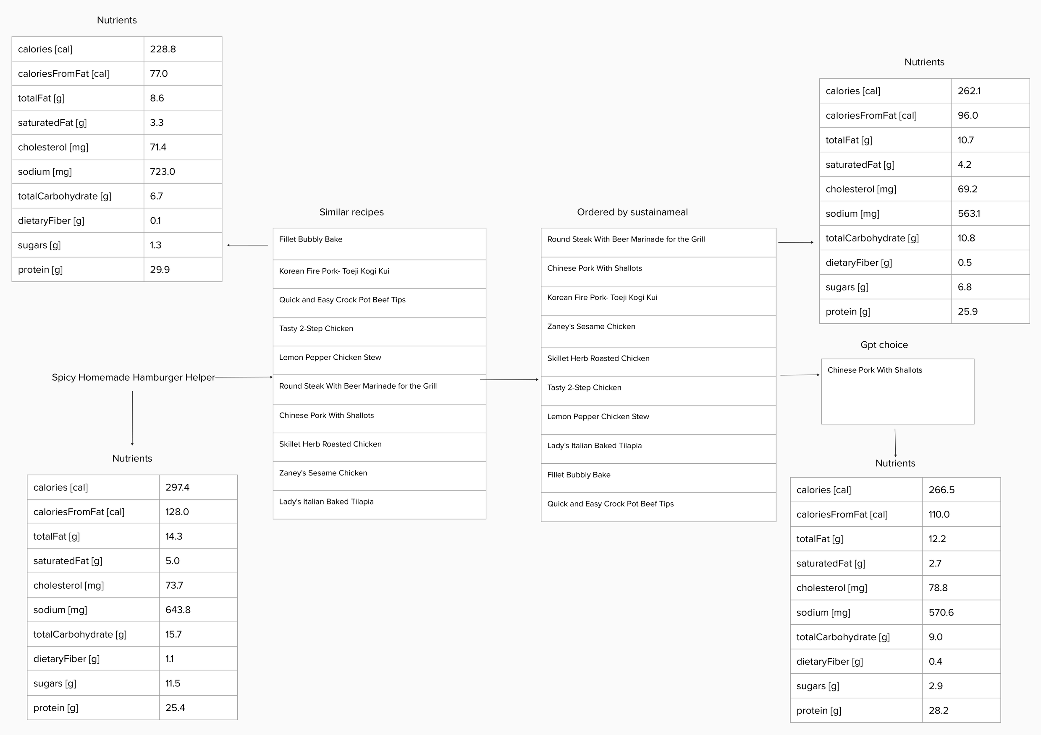
Qualitative
Analisis
2
Spicy Homemade Hamburger Helper

Slide 64
CONLUSION AND FUTURE WORKS

Slide 65





Conlusion and Future Works
01
Improve dataset preprocessing with a more refined data cleaning process to achieve
even more accurate and reliable results
Implement a query engine to justify the results obtained by the system, enhancing
transparency and understanding of the decision-making process
02
Explore further insights into alternative research, including new algorithmic approaches or the integration of additional data sources to further improve the diversity
and quality of generated proposals.
03

Slide 66
QUESTIONS?

Slide 67
THANK YOU
Giovanni Tempesta
Michele Di Carlo

